Slide 1

Unleashing the power of laravel
A Comprehensive Journey Into Modern Web Development With Laravel Framework
Group Members: Reg No:
Fiza Ismail 2112178
Umair Solangi 2112203
Hamza Bin Javed 2112180
M.Ahmed Asim 2112190
Ibrahim Khalilullah 2112181

Slide 2
Introduction
Laravel is an open-source PHP web framework. It is freely available for developers to use, modify, and contribute to.
MVC Architecture:
Follows the Model-View-Controller (MVC) architectural pattern.
Ensures a structured and organized approach to web development.
Expressive Syntax:
Laravel offers an expressive and readable syntax.
Enhances developer productivity and makes code more enjoyable to write and maintain.
Rich Set of Features:
Includes a feature-rich set of tools and components.
Eloquent ORM, Blade templating, Artisan console, and Laravel Mix are among its standout features.

Slide 3
Key Features:
Eloquent ORM:
Laravel includes Eloquent, an elegant and intuitive object-relational mapping (ORM) system.
Simplifies database interactions and allows developers to work with databases using expressive syntax.
Blade Templating Engine:
Utilizes the Blade templating engine for creating dynamic views.
Balances power and simplicity in template design.
Artisan Console:
Comes with Artisan, a command-line tool automating various tasks.
Facilitates database migrations, testing, and code generation.
Middleware:
Laravel uses middleware for filtering HTTP requests.
Middleware can handle tasks like authentication, logging, and request/response modification.

Slide 4
Setup / Configuration
Install Composer:
Composer is a dependency manager for PHP. You can download and install it from getcomposer.org.
Install Laravel Installer:
Run the following command in your terminal or command prompt:
“composer global require laravel/installer”
Create a New Laravel Project:
Navigate to the directory where you want to create your Laravel project and run:
“composer create-project laravel/laravel example-app”

Slide 5
Setup / Configuration
Serve the Application:
Running php artisan serve in Laravel starts a local development server, allowing you to easily test and view your application during development. This command launches the server, and you can access your Laravel application through a web browser using the provided URL, typically http://127.0.0.1:8000 or http://localhost:8000.
“php artisan serve”
Link for Laravel Documentation:
https://laravel.com/docs/10.x

Slide 6
Importance of routing in Laravel
Routing forms the backbone of any web application, allowing us to define URLs and map them to specific actions or controllers in our Laravel application.
ROUTE
URL

Slide 7
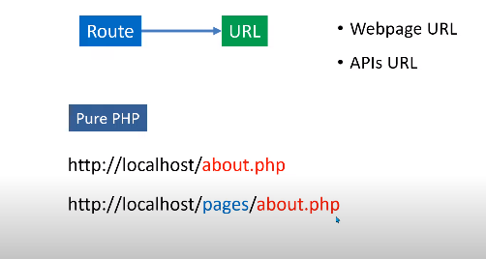
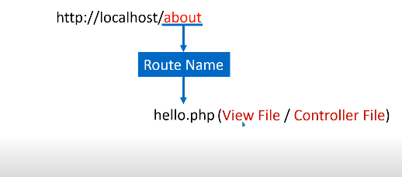
Explain URL
PHP URL
LARAVEL URL

Slide 8
Basic Routing in Laravel
Defining routes in web.php
We can define routes in the web.php file using a simple and intuitive syntax, mapping URLs to actions or controllers.
Route parameters
Dynamic routes allow us to handle variable portions of a URL, enabling powerful and flexible routing strategies.
Pass dynamic parameters in your routes to handle varying user inputs and customize the web application experience.

Slide 9
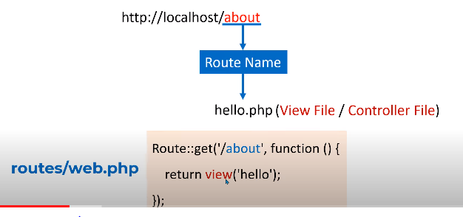
Explain Routes:

Slide 10
Route Actions and Controllers
Route actions are callbacks that execute when a specific route is requested, allowing us to handle the logic associated with that route.
Define routes to handle HTTP methods and corresponding actions using the simple syntax provided by Laravel.
Creating route
Controllers provide a structured way to organize route handlers and separate business logic from presentation logic.
Delegate route handling logic to controllers to improve code organization and implementation flexibility.
Controllers route

Slide 11

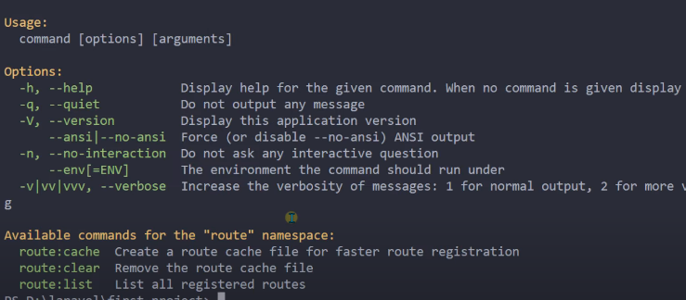
Routes Commands

Slide 12
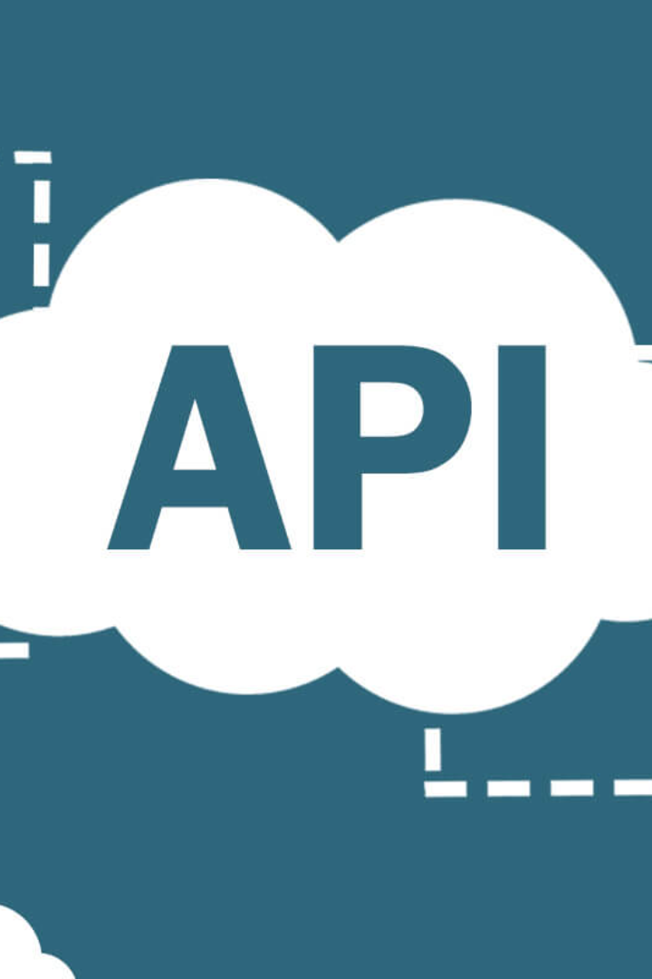
APIs in Laravel

Slide 13

Introduction
In this presentation, we will explore the world of APIs and their significance in web development. We will also take a closer look at the powerful Laravel framework.

Slide 14
APIs in Laravel
What is Laravel?
Introduction to Laravel APIs
Laravel is a PHP framework known for its elegant syntax and extensive features. It provides a solid foundation for building robust web applications.
Laravel APIs allow developers to easily create and expose web services, enabling seamless integration with other applications and systems.
Types of APIs in Laravel
Benefits of using APIs in Laravel
Laravel supports various types of APIs, including RESTful APIs, GraphQL APIs, and JSON APIs, offering flexibility and versatility in development.
By leveraging Laravel APIs, developers can enhance code reusability, improve scalability, and foster collaboration between different platforms and teams.

Slide 15
Developing APIs in Laravel
1
Setting up a Laravel project
Learn how to install Laravel, configure the project environment, and get your development environment up and running in no time.
Creating and configuring API routes
2
Discover how to define API routes in Laravel, handle different HTTP methods, and establish the necessary endpoints for your API.
3
Implementing API controllers
Master the art of creating API controllers in Laravel, allowing you to organize your code, manage request handling, and control API logic.
Handling API requests and responses
4
Explore techniques for handling API requests and responses, including data validation, error handling, and delivering meaningful responses to clients.

Slide 16

Authentication and Authorization in Laravel APIs
1
Understanding API authentication methods in Laravel
Implementing token-based authentication
2
Dive into the world of API authentication and learn about the different options available in Laravel for securing your API endpoints.
Learn how to implement token-based authentication in Laravel APIs, providing a secure and scalable authentication mechanism for your users.
3
Role-based access control in Laravel APIs
Discover how to implement role-based access control in Laravel APIs, granting specific permissions to users based on their assigned roles.

Slide 17

API Testing and Documentation in Laravel
1
Introduction to API testing
Explore the importance of testing APIs and learn how to write automated tests in Laravel to ensure the reliability and stability of your APIs.
2
Implementing API testing in Laravel with PHPUnit
Understand how to use PHPUnit to write comprehensive API tests, covering different scenarios and validating the functionality of your APIs.
3
Documenting Laravel APIs using Swagger
Learn how to use the Swagger documentation tool to generate interactive API documentation for your Laravel APIs, making it easier for developers to understand and consume your APIs.

Slide 18
Database Connectivity:
Composer Laravel Mysql

Slide 19
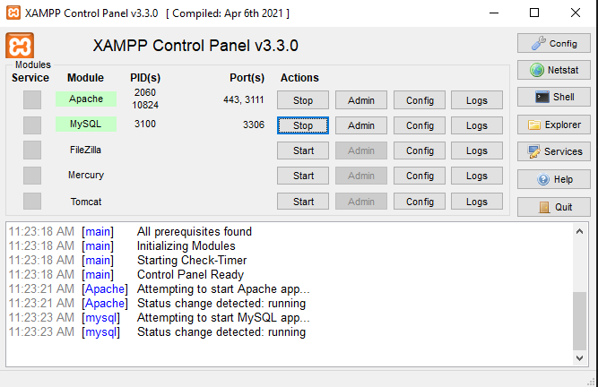
Database Connectivity:

Slide 20
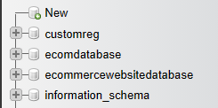
Database Connectivity:

Slide 21
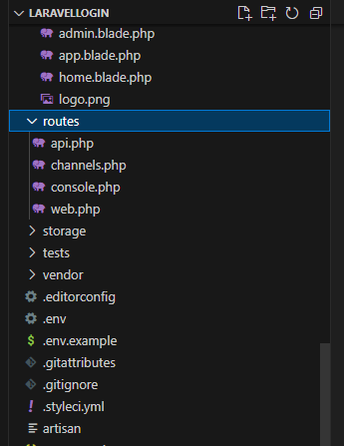
Database Connectivity:

Slide 22
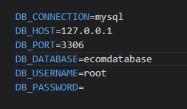
Database Connectivity:

Slide 23
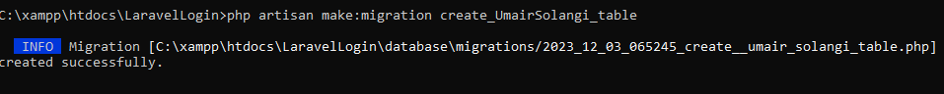
Database Connectivity:

Slide 24
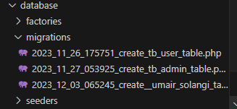
Database Connectivity:

Slide 25
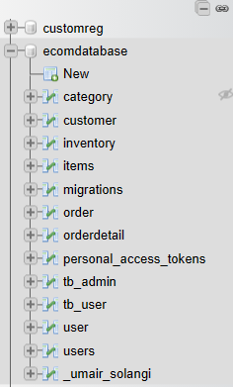
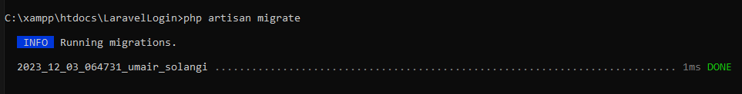
Database Connectivity:

Slide 26
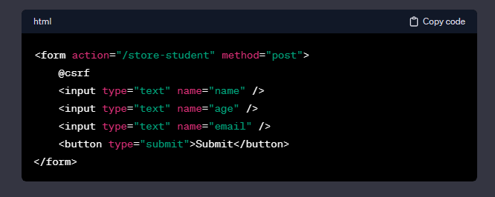
Database Connectivity:

Slide 27

Database Connectivity:
// routes/web.php
//use App\Http\Controllers\UserController;
Route::post('/students', [UserController::class, 'storeStudent'])->name('students.store');

Slide 28
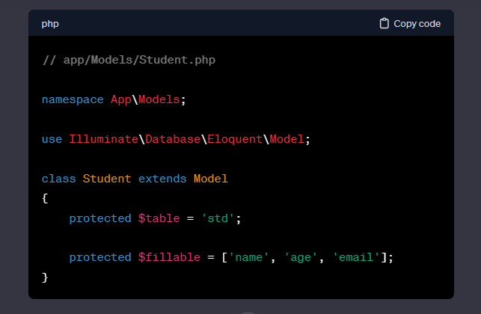
Database Connectivity:

Slide 29
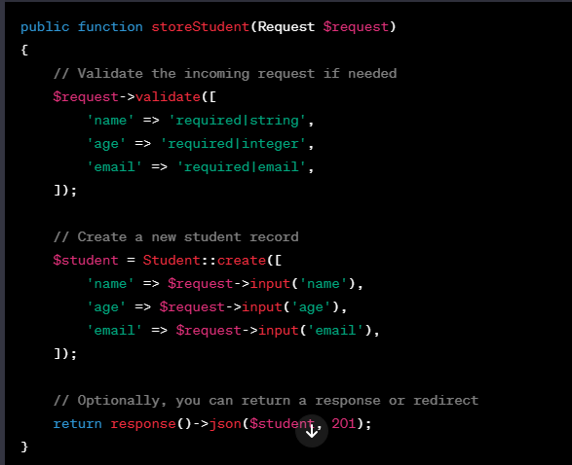
Database Connectivity:

Slide 30

Database Connectivity:
php artisan
publishes all our schema to the database

Slide 31

Database Connectivity:
php artisan

Slide 32
Thank You

